Slide 1
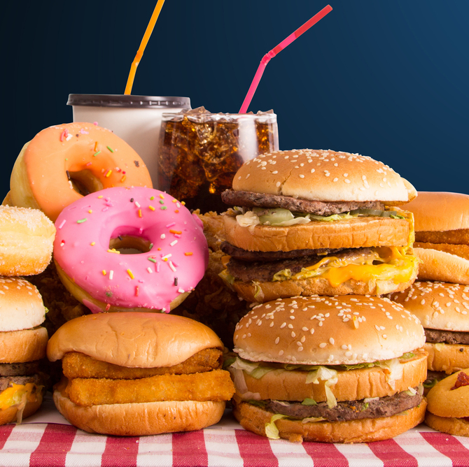
Yelp Restaurants Rating
Data Mining And Machine Learning Final Project
Dor Mordehai 206898645 Lin Ben- Moyal 318228558

Slide 2

Yelp- Introduction
What Is Yelp?
Founded in 2004, Yelp is a popular online directory for discovering local businesses ranging from bars, restaurants, and cafes to hairdressers, spas, and gas stations.
How Does Yelp Work?
You can search Yelp via its website or with the official apps on iOS and Android smart devices. Listings are sorted by business type and results are filtered by geographical location, price range, and unique features like outdoor seating, delivery service, or the ability to accept reservations.
Yelp has a strong social aspect and encourages its users to leave written reviews, star ratings, and photos of their experience with each business they visit.

Slide 3

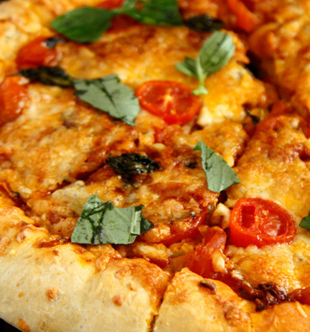
Our Research
Research Question:
Is it possible to predict the restaurant's rating on yelp according to its features, location and review count?
What pattern can we observe and what conclusions can we learn from them?

Slide 4
Main Steps
OBTAINING DATA
SCRUBBING DATA
Cleaning formatting and filtering the data
EXPLORING DATA
Visualizing and understanding the data
API calls and web crawling for collecting data
MACHINE LEARNING
INTERPRETING DATA
Train and predict the data
Understanding and delivering the data, conclusions

Slide 5


Yelp API
We Used Yelp’s API to collect data about restaurants in three big cities in USA: New York, Los Angeles and Miami
The data of any restaurant include: name, street, zip code, rating, price, category, review count, url and more.

Slide 6
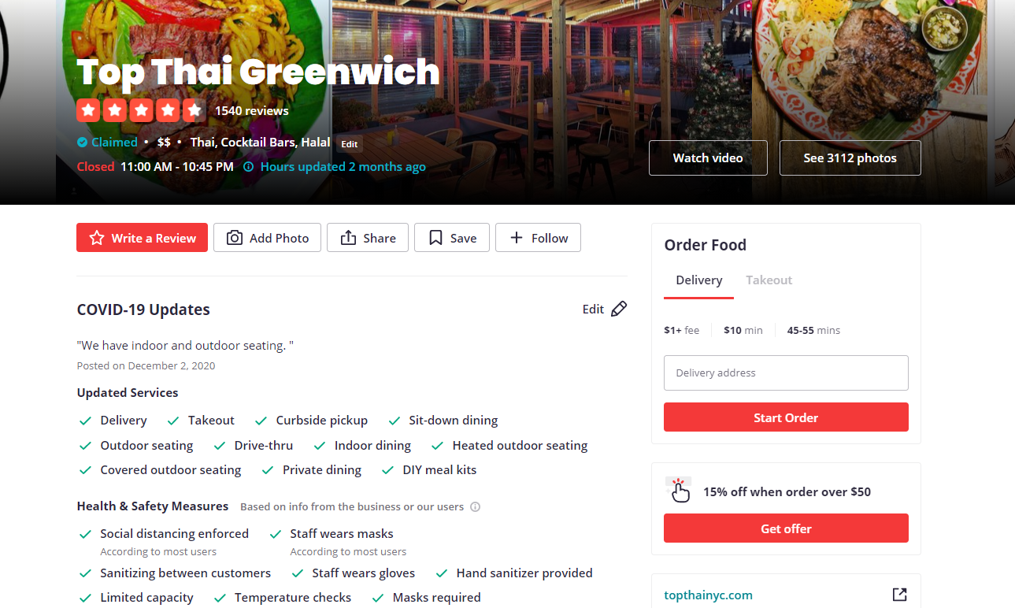
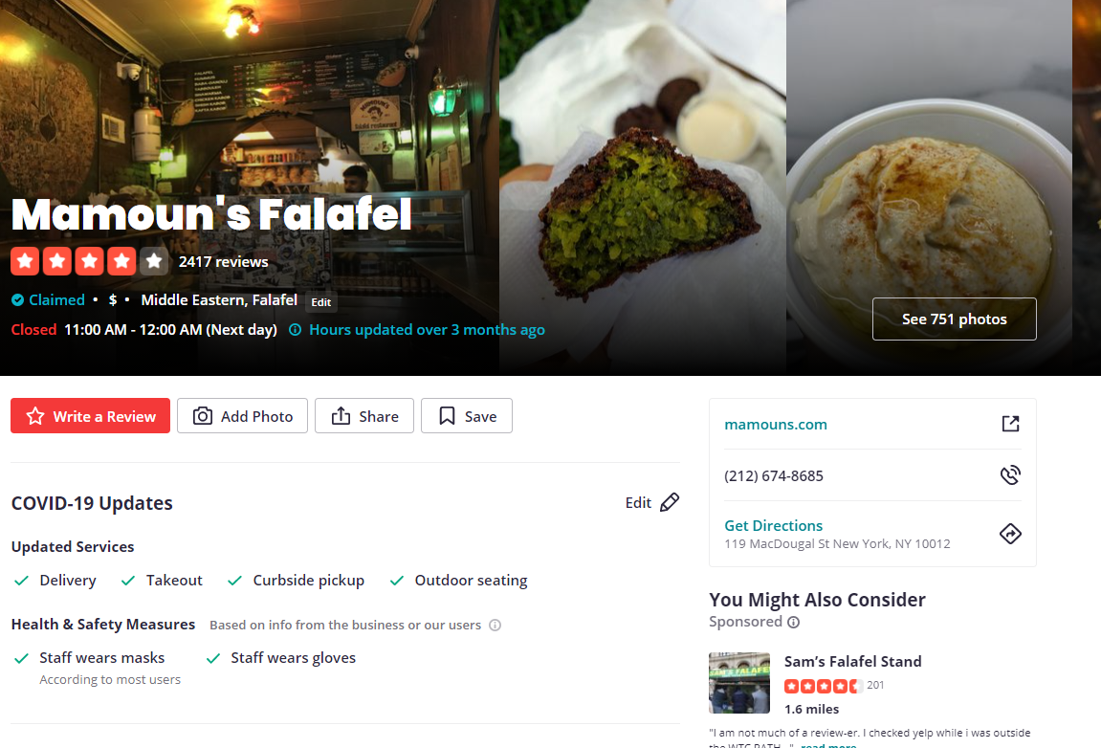
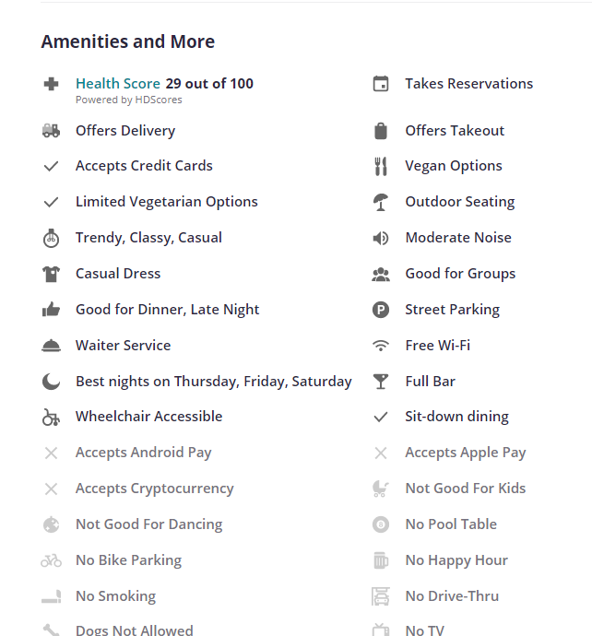
Web Crawling
We used the url’s restaurants from the API request to crawl more information about the restaurant.
This information include different features of the restaurant like vegan options, free- Wi-Fi, dog allowed , waiter service and more.
*we used selenium library because some of the information was hidden behind button in the html page

Slide 7
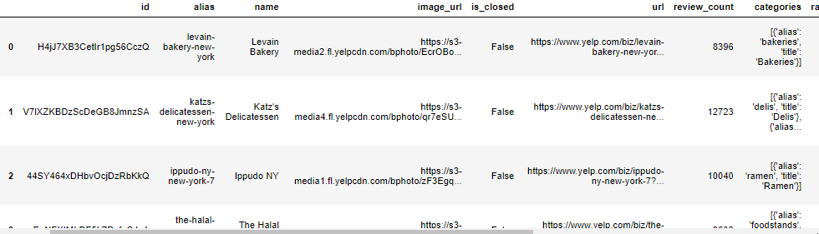
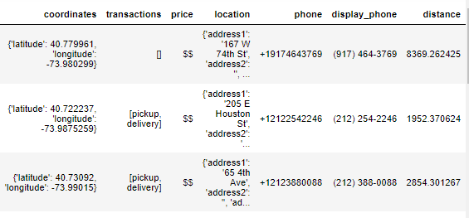
DataFrame
Finally, we created a Dataframe with 3000 different restaurants and their characteristics

Slide 8

Scrubbing Data
Formatting:
Splitting columns such as address into some columns of state, city and zip code. In addition, each restaurant had up to 3 different categories so we take just the first category
Dealing with missing values:
Some of the restaurants were without price value, so we fill the cell with the price’s median.
Remove unnecessary data:
Remove from the dataframe unnecessary data cells like url, image url, is closed and more. In addition, we removed business that are not restaurants.
Transfer to numeric:
Transfer non-numeric values to numeric

Slide 9
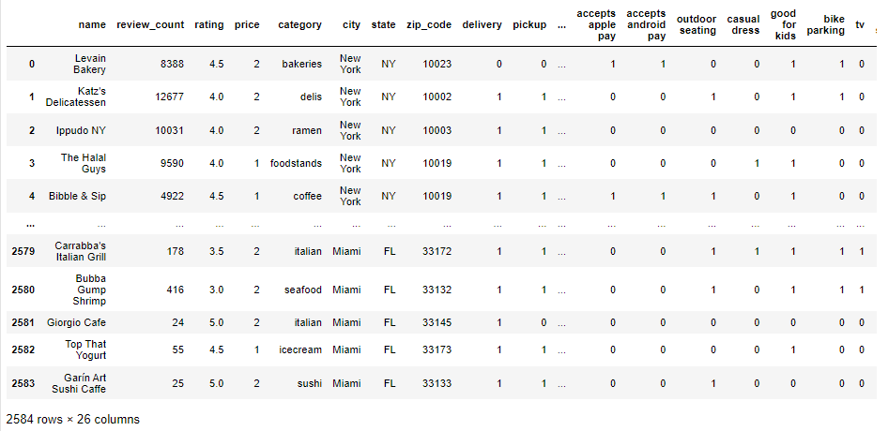
Full Restaurants DataFrame

Slide 10

Exploring Data and Visualization
We Used “seaborn” and “matplotlib” libraries to graph visualization

Slide 11
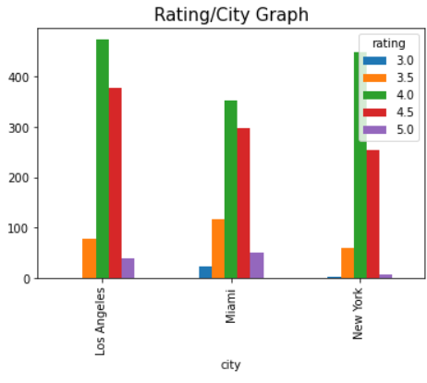
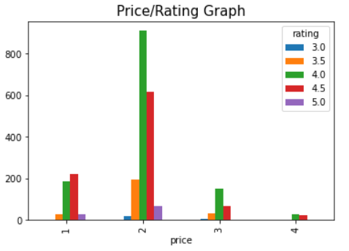
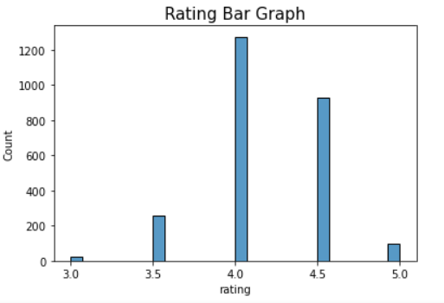
Restaurants Rating
The graph shows the rating in each city: NY, Miami an LA
The graph shows the rating in relation to the price of the restaurant
The graph shows count of restaurants in each rating

Slide 12
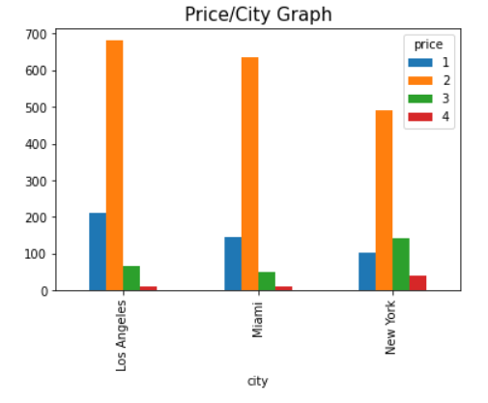
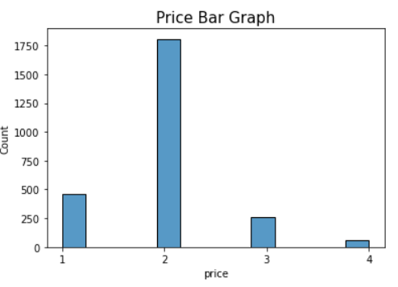
The graph shows price in each city: NY, Miami an LA
The graph shows count of restaurants in each price
Restaurants Price

Slide 13
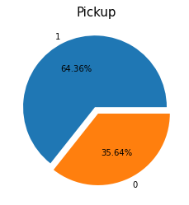
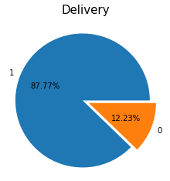
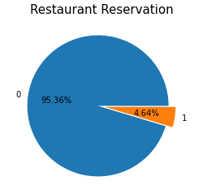
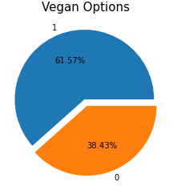
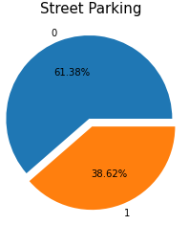
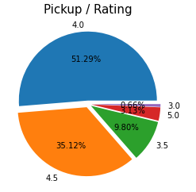
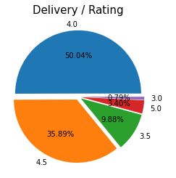
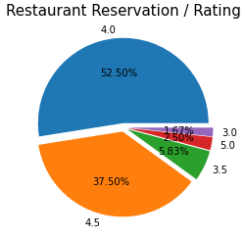
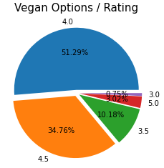
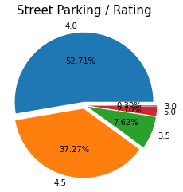
Restaurants Features Visualization

Slide 14
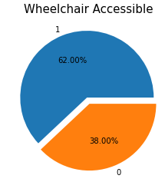
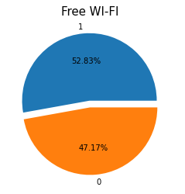
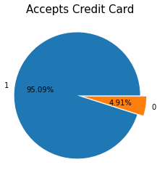
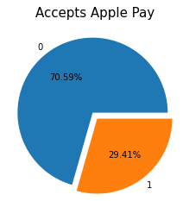
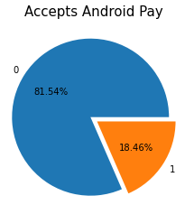
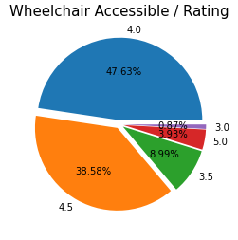
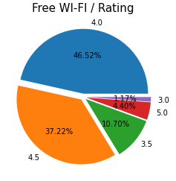
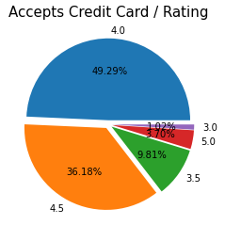
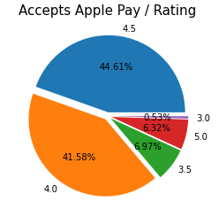
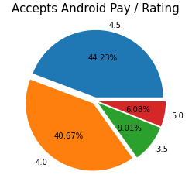
Restaurants Features Visualization

Slide 15
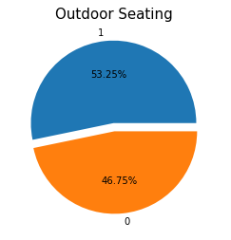
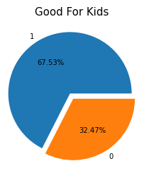
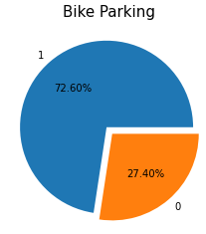
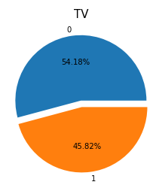
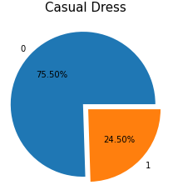
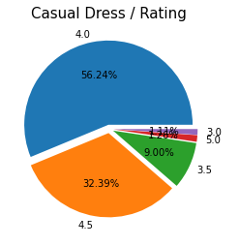
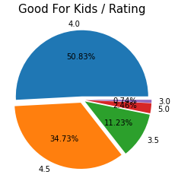
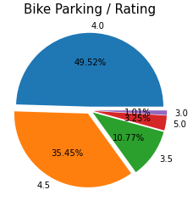
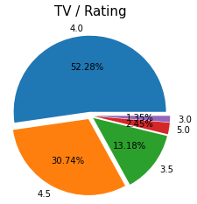
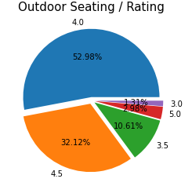
Restaurants Features Visualization

Slide 16
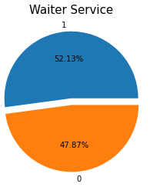
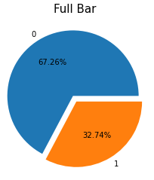
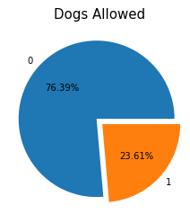
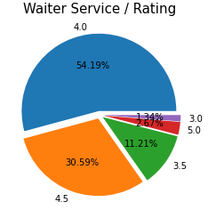
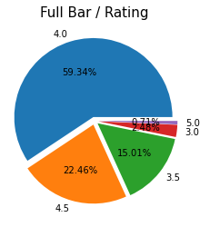
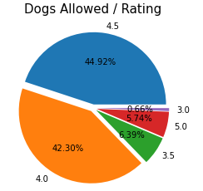
Restaurants Features Visualization
Main Conclusions:
Restaurants that Accepts Apple Pay have the most with rating 5
Restaurants that Accepts Android Pay didn’t received at all rating 3
Accepts Credit Card is the most popular feature
Restaurant Reservation is the most unpopular feature

Slide 17

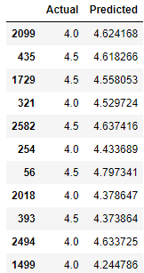
Machine Learning
We used MinMaxScaler() function to Normalize the zip code and review count columns
Then, we split the datafrare to X_train, X_test, y_train, y_test and trained a model that predicts the restaurant’s rating by using ‘sklearn’ library and linear regression

Slide 18





Interpreting Data
Lets look on the Linear Regression Details:

Slide 19


We did not get as accurate a prediction as we wanted
The data taken from yelp is not a significant factor that can determine a restaurant's rating
Points to Improvement:
To pinpoint the research question
Get more data about the restaurants
Add more restaurants for the train model

